Slide 1
LINEAR REGRESSION
Artificial Intelligence And Machine Learning
MULTIPLE LINEAR REGRESSION – PREDICTION FUNCTION
Revisiting our prediction function, we now have:
f_wb(X) = W.X + b
where,
W = weight vector
X = input vector
W.X = dot product of W and X
b = bias
meaning on expanding the function, we get:
f_wb(X) = w[1]X[1] + w[2]X[2] + w[3]X[3] + ….. + w[n]X[n] + b

Slide 2
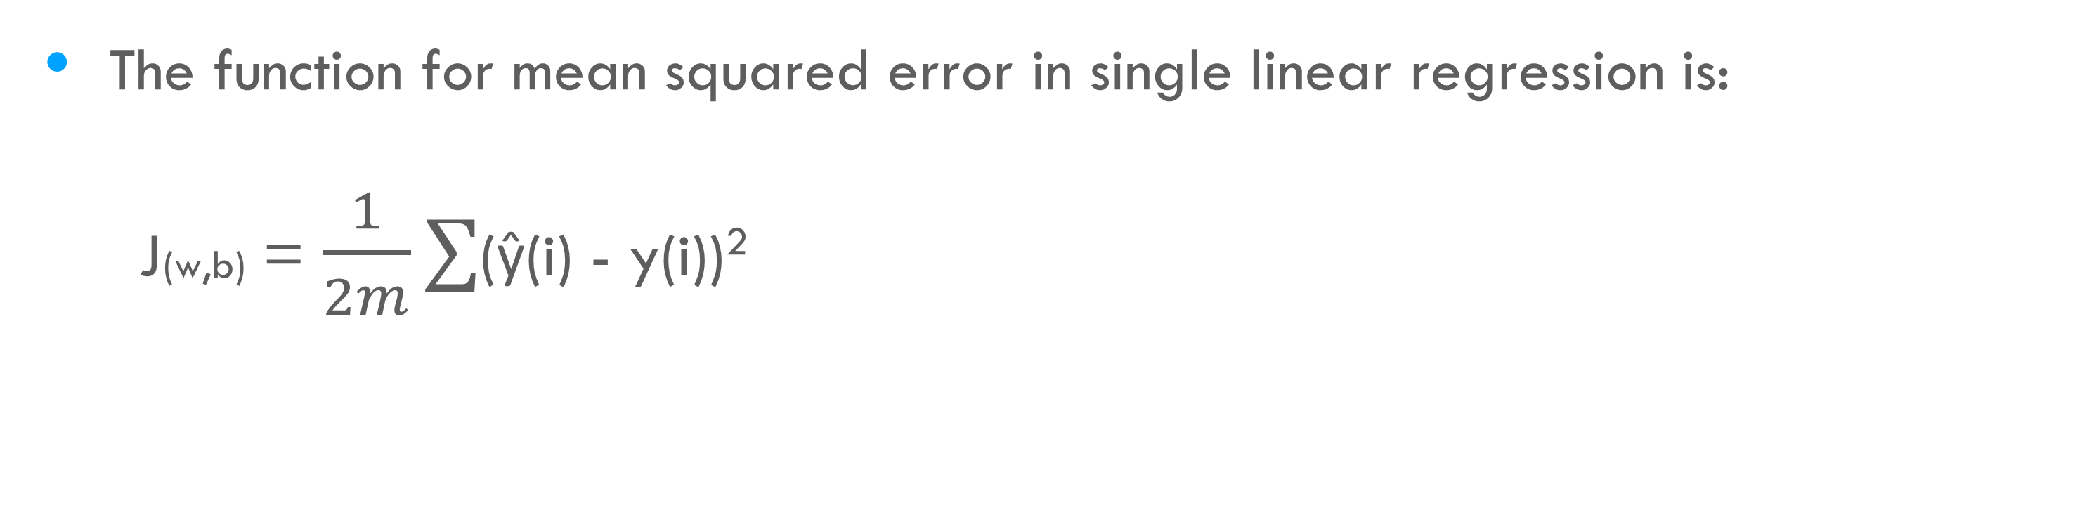
LINEAR REGRESSION
Artificial Intelligence And Machine Learning
MULTIPLE LINEAR REGRESSION – COST FUNCTION
The function for mean squared error in single linear regression is:
J(w,b) = $\frac{1}{2m}∑$(ŷ(i) - y(i))²
The cost function will not differ in multiple linear regression much. The only change is how our ŷ(i) (which is the prediction f_wb(X)) is calculated.

Slide 3
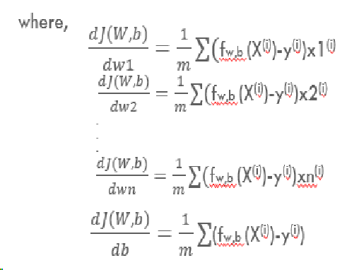

LINEAR REGRESSION
Artificial Intelligence And Machine Learning
MULTIPLE LINEAR REGRESSION – GRADIENT DESCENT
For gradient descent, we update our parameters similarly to single linear regression, except we find the gradient and update for every feature independently, i.e., for all the weights in our weight vector W.
w1 = w1 - $a\frac{d}{dw1}$ J(W,b)
w2 = w1 - $a\frac{d}{dw2}$ J(W,b)
.
.
.
wn = wn - $a\frac{d}{dwn}$ J(W,b)
b = b - $a\frac{d}{db}$ J(W,b)

